Slide 1
EMPLOYEE DATA ANALYSIS USING EXCEL
^{STUDENT NAME : KRISHA}
^{REGISTER NUMBER: 422200495}
NM ID: 37EFF7F73AFFBA5999441FD05FA2BED
^{Department: BCOM (ISM)}
College name: VALLIAMMAL COLLEGE FOR WOMEN

Slide 2
Project title : Employee Performance Analysis using Excel
AGENDA
• PROBLEM STATEMENT
• PROJECT OVERVIE
END USERS
• OUR SOLUTION AND PROPOSITION
• DATA DESCRIPTION
• MODELING APPROACH
• RESULTS AND DISCUSSION
• CONCLUSION

Slide 3
Problem statement
ANALYSING EMPLOYEE PERFORMANCE ENABLESORGANIZATIONS TO OPTIMIZE PRODUCTIVITY BY ENSURINGTHAT EMPLOYEES ARE WORKING EFFICIENTLY ANDEFFECTIVELY TOWARDS THEIR GOALS.

Slide 4
Project overview
ANALYZE THE SALARY OF THE EMPLOYEE BY CONSIDERINGVARIOUS FACTORS LIKE GENDER, EMPLOYEE ID, START DATE,EMPLOYEE TYPE, DEPART MENT ETC. DIFFERENT CATEGORIES OFEMPLOYEE SALARY LIKE VERY HIGH, HIGH, MEDIUM AND LOW

Slide 5
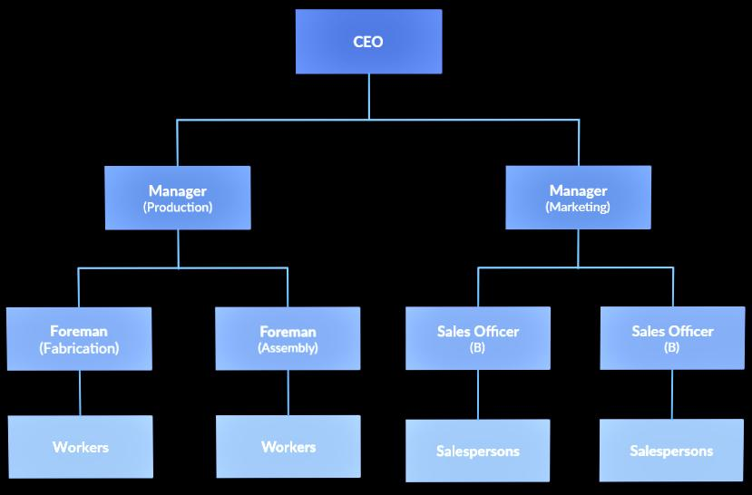

Who are the end user

Slide 6
Our solution and It’s value Proposition
• CONDITIONAL FORMATTING - MISSING
• FILTER –REMOVE
• FORMULA - PERFORMANCE LEVEL
• PIVOT- SUMMARY
• GRAPH - DATA VISUALIZATION

Slide 7
Dataset description
EMPLOYEE DATASET - EDUNET DASHBOARD
26 - FEATURES
9 - FEATURES
•EMPLOYEE ID - NUMERICAL VALUE
• NAME – TEXT
GENDER – TEXT
SALARY - NUMERI CAL VALUE
START DATE - NUMERICAL VALUE

Slide 8
The”wow” In our solution
WE USE THIS FORMULA
IFS(Z8>=5;VERY HIGH",Z8>=4,'HIGH",Z8>=3,MED", TRUE",LOW")

Slide 9
Modeling
DATA COLLECTION
NAN MUDHALVAN
EDUNET DASHBOARD
FEATURE SELECTION
26 FEATURES
•9 FEATURES
DATA CLEANING
• COLOUR BLANK VALUES
• FILTER - REMOVE BLANK VALUES

Slide 10
Salary level
VERY HIGH
HiGH
MEDIUM
• Low
PIvOT TABLE
EMPLOYEE ID
NAME
GENDER
SALARY
SALARY LEVEL
START DATE
EMPLOYEE TYPE

Slide 11
Chart
• EMPLOYEE ID
• NAME
•GENDER
• SALARY
• SALARY LEVEL
•START DATE
• EMPLOYEE TYPE
• DATA VISUALIZATION

Slide 12
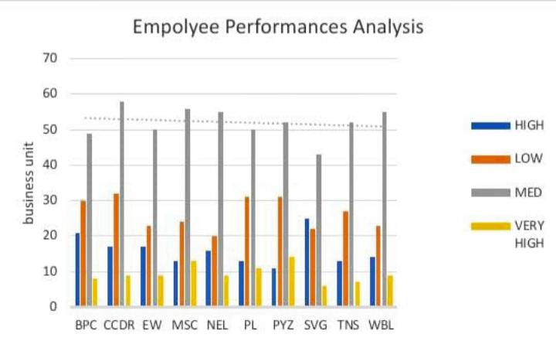
Results

Slide 13
Conclusion
• WHILE COMPARING THE SALARY LEVEL OF THE EMPLOYEE,THE EMPLOYEES ARE GETTING THEIR SALARY ACCORDINGTO THEIR EMPLOYEE TYPE AND START DATE.

